Slide 1

LHearts
Leader: Shayna
Co-leader: Yi Ling
Members:
Angelica
Cherilynn
Emily

Slide 2
An LHearts production:
Fishno High School and University
Where you hate teachers not from Fishno…
Fun.Awesomeness.Cool.
Principal: Mr Shit
Teacher: Miss Shayna Chua
Students: Angelica
Cherilynn
Emily
So What are you waiting for?
Join us now!

Slide 3
More on topics taught in Fishno High School and University…
Music
Science
Physics
Chemistry
History
Geography
And more!

Slide 4
Little bit about Physics…
Physics is:
A thing
Another thing
Basically a thing
Something
Mr Bontan Lingolodo created Physics
He created Physics because he wanted to.
More in Fishno High School and University!

Slide 5
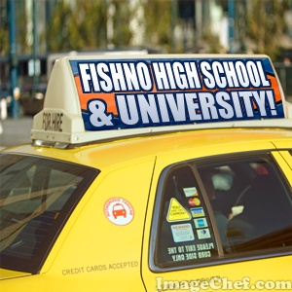

Lhearts and Fishno Advertisements!

Slide 6
About LHearts
We are made up of 5 girls
We created Fishno University and High School
We created new words!
New words:
Boo Ya!
Peace!
I Dun give shit
Hush Boy
Chicken nuggets
Lollicious
Sweet nibblets
And more!

Slide 7
Thank You !
Please join Fishno >
BooYa!

